Slide 1
Introduction to Machine learning
Vu Tuan Hai
University of Information technology, VNUHCM

Slide 2
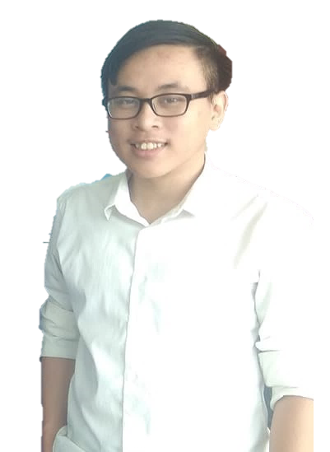
About me
Bachelor’s degree in Software engineering from 4/2021.
Teaching assistant at UIT, VNUHCM.
Email: vutuanhai237@gmail.com

Slide 3
Machine learning
“Learning is any process by which a system improves performance from experience.”
“Machine learning is concerned with computer programs that automatically improve their performance through experience.”
- Herbert Alexander Simon

Slide 4

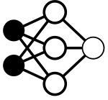
From educational perspective
Energy | Food | Computation power
Data | Book | Dataset
Training | … | …
Testing | … | …

Slide 5
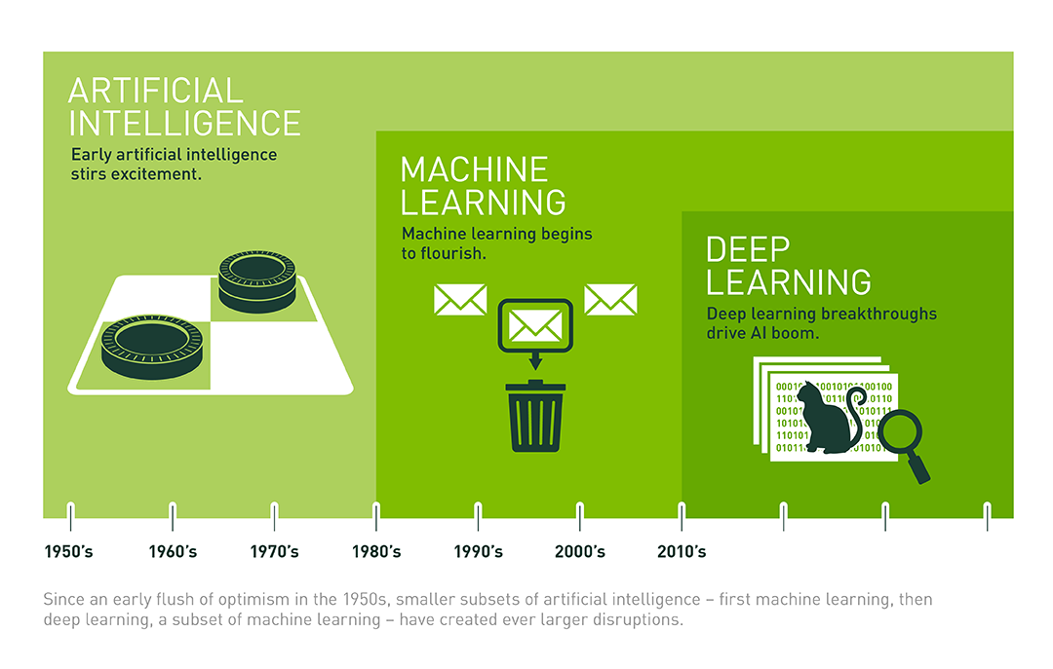
History

Slide 6
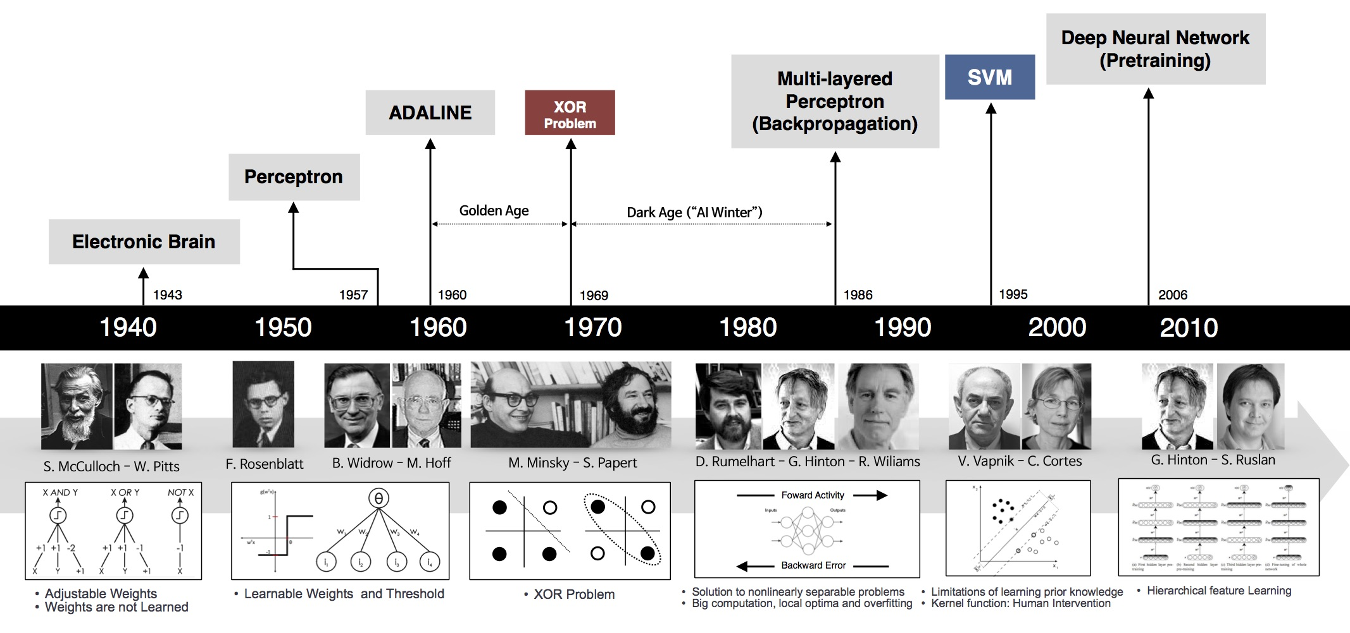
History

Slide 7
Why machine learning?
Data mining: get new knowledge from big data
Ex: Predict stock prices
A software that can automatically upgrade and adapt to individual users.
Ex: Facebook newfeed
Mimic human which require some intelligence
Ex: Recognize, classification, …

Slide 8
Why’s it hot now?
Computational power: NVIDIA, AMD, Intel, …
The increasing of big data: from huge of the internet user.
New algorithms and techniques
Support from governments and industries

Slide 9
Its applications
Computer vision: recognition, human - machine interaction, …
Natural language processing (NLP): text mining, recommend system, artificial voice, …
Other: fin-tech, bioinformation, physis, chemistry, …

Slide 10
The concept of learning in Machine learning
Learning = Improving the performance P with experience E at task T
Task T: recognize, classify, predict, …
Experience E: images, texts, time-series, …
Performance P: accuracy, F1-score, IoU, MAPE, …

Slide 11
Example: Filter spam email
An email will be classified as a normal email or spam email.
T: classify (or identify)
E: database of email (text) that were labeled by user.
P: accuracy (%) = |correct label| / |total email|

Slide 12
Learning process
Data set
Model
Preprocessing
Clean dataset
Train set
Learning
Software Backend
- Noise filtering
- Normalization
- Feature selection
- Dimensionality reduction
Export
Model
Data preparation
Test set
Model Testing
Environment:
Sensor, Database, Cam, …
Update
Analyze

Slide 13
In our example
Mail content
Mail attachments
…
{content1, spam}
{content2, not-spam}
…
Classifier
Learning
Mail content
Mail Filtering system
Feature selection
Export
Model
Query & assign label
{content8}
{content9}
…
Accuracy
Mail server
Update
Analyze

Slide 14
Dataset
The dataset is splitted into train set and test set (or train – val – test)
{content1, spam}
{content2, not-spam}
…
{content8, spam}
{content9, spam}
{content10, spam}
Train set:
{content1, spam}
{content2, not-spam}
…
Test set:
{content9}
{content10}
Test label:
{spam}
{spam}

Slide 15

Linear classifier
$$y=w_{0}+w_{1}x$$

Slide 16
Linear classifier

Slide 17
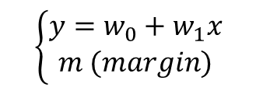
Linear classifier – add more parameters
$$\left\{\begin{aligned}y=w_{0}+w_{1}x \\ m (margin)\end{aligned}\right.$$

Slide 18
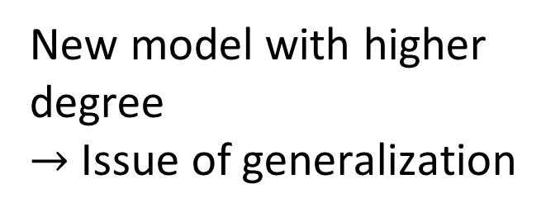
No linear classifier can cover all instances
New model with higher degree
$→$ Issue of generalization

Slide 19
Which one?

Slide 20
Overfitting and underfitting
Loss value
Underfitting
Overfitting
Test error
Best fit
Training error
Epoch

Slide 21
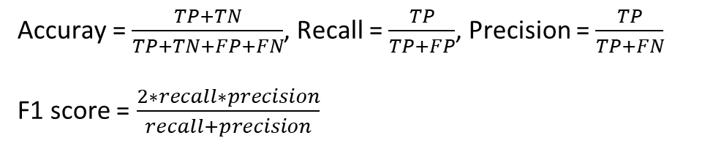
Model testing
Confusion matrix
Predict spam
Predict non-spam
True positive 3 | False negative 1
False positive 1 | True negative 4
Actual spam
Actual non-spam
Accuray = $\frac{TP+TN}{TP+TN+FP+FN}$, Recall = $\frac{TP}{TP+FP}$, Precision = $\frac{TP}{TP+FN}$
F1 score = $\frac{2∗recall∗precision}{recall+precision}$

Slide 22
Model testing
Confusion matrix
Predict spam
Predict non-spam
True positive 3 | False negative 1
False positive 1 | True negative 4
Actual spam
Actual non-spam
Accuray = $\frac{TP+TN}{TP+TN+FP+FN}$, Recall = $\frac{TP}{TP+FP}$, Precision = $\frac{TP}{TP+FN}$
F1 score = $\frac{2∗recall∗precision}{recall+precision}$

Slide 23
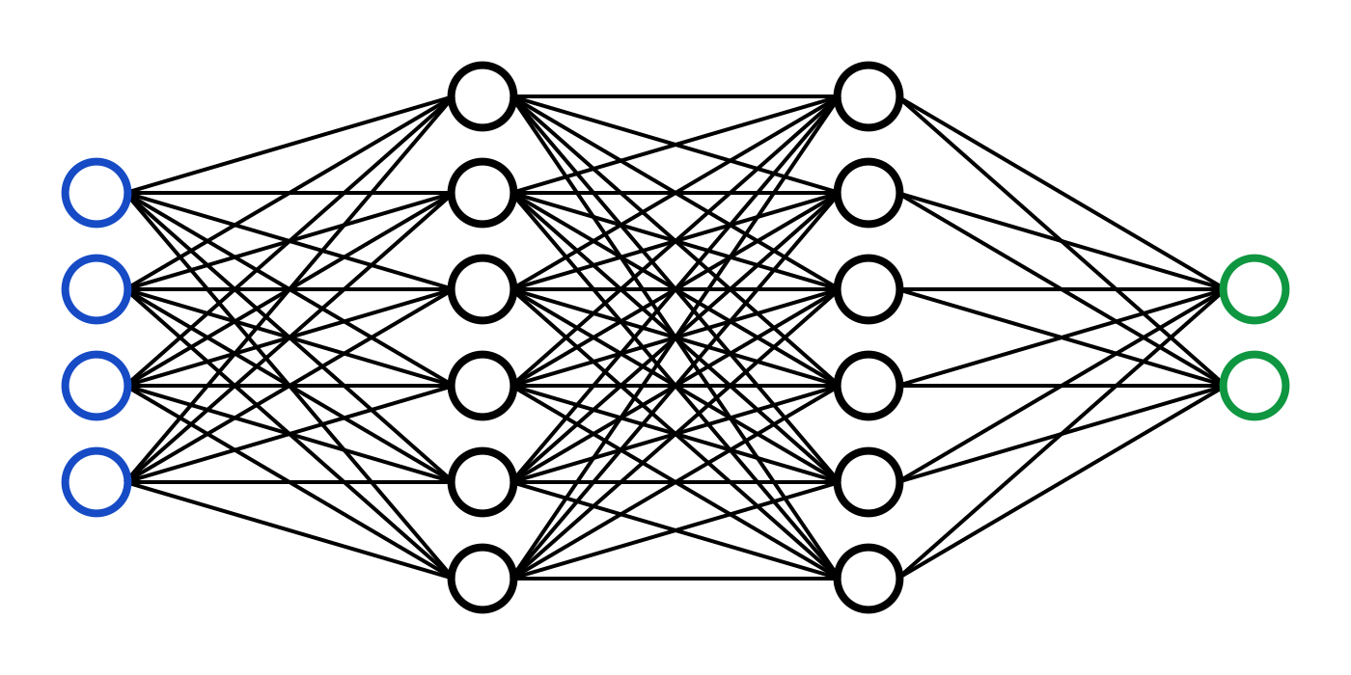

Deep learning – Neural network
Hidden layer
Input
Output

Slide 24
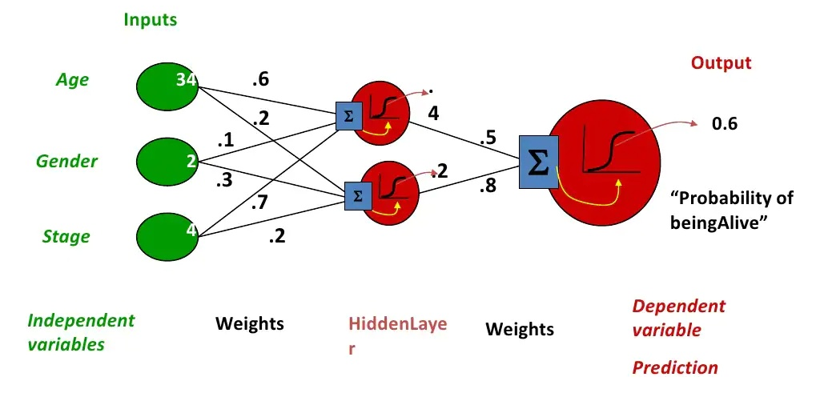
Neural network
Non-linear function

Slide 25
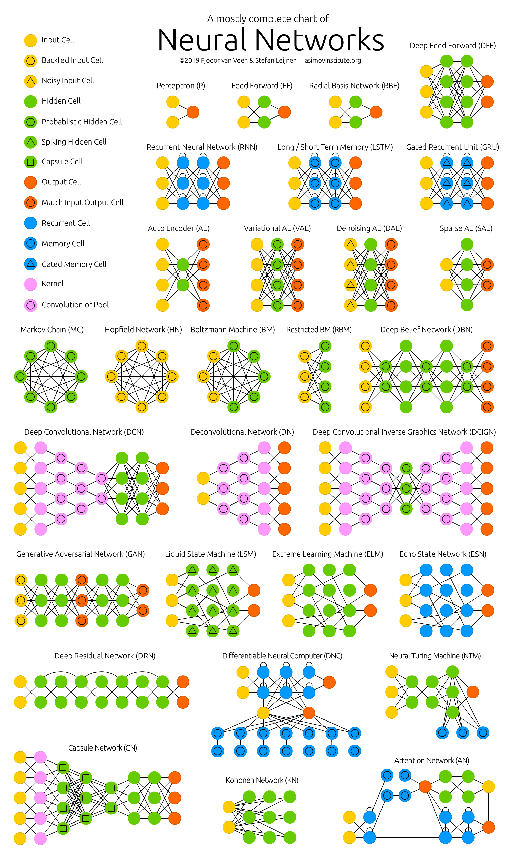
DNN
Some famous architechtures:
Computer vision:
Alexnet
Resnet
CNN
Natural language processing:
GRU
RNN
LSTM
Generating task:
Auto-encoder
VAE
GAN: WGAN, CycleGAN, Pix2Pix

Slide 26
Other learning task
Supervised learning
Unsupervised learning
Transfer learning
Online learning
Federated learning
…

Slide 27







Software
Framework (Python):
Tensorflow, Keras
Pytorch
Computational services:
Google Colab
MS Azure
AWS

Slide 28









Software
Higher-level
interface
Python package
Python library
Python framework
ML API

Slide 29
What we need to do?
Data set
Preprocessing
Clean dataset
- Noise filtering
- Normalization
- Feature selection
- Dimensionality reduction
Data preparation
Environment:
Sensor, Database, Cam, …
Update

Slide 30
Thanks for listening
Q&A

